Slide 1
Areal Wombling
Sameer Singh Rawat, LMU

Slide 2
Overview
Introduction - What is wombling?
Crisp Vs Fuzzy Wombling
Crisp Areal Wombling
Traditional approach
Hierarchical Modelling approach
Traditional Vs hierarchical approach
Results
Github link - https://github.com/SameerR007/ArealWombling_Project

Slide 3
Introduction
Wombling (also known as edge detection or barrier analysis) refers to the techniques of identifying edges or boundaries of rapid change.
It is named after William H. Womble (statistician).
Uses -
a. Environmental Sciences (to detect boundaries between different ecological zones).
b. Public health (to detect boundaries where disease rate changes significantly).
Two type of wombling - Crisp areal wombling and Fuzzy areal wombling.

Slide 4
Crisp Vs Fuzzy Wombling
Boundaries are sharp and clear identifying the regions of significant change.
A threshold c is fixed and boundary is considered if the Boundary likelihood value (difference between the regions) exceeds this threshold c.
It can be used in fields for understanding significant change of attribute like detecting significant change of disease rate or significant change of environmental or ecological variables.
It allows for gradual change between the regions, hence boundaries can be unclear.
It makes use of probability to assign likelihood of boundary existing.
It can be used to understand gradual change of attribute values.

Slide 5
Crisp Areal Wombling

Slide 6
Crisp Areal wombling
In this project we will be focussing on crisp areal wombling.
For this we have taken the dataset for covid cases occurring in USA in April 2020.
Data contains the deaths recorded and confirmed covid cases in April 2020 and we have taken Standardized Death Rate (SDR) as a measure to investigate which are the states where covid control measures differ significantly, perhaps indicating the scope of improvement in such states.
Also for performing bayesian hierarchical modelling we have included the covariates such as number of Hospital beds per 1000 people and percentage of people with age above 65. And this data is taken for year 2019 to avoid any biases that might occur due to changes in these figures after April 2020.

Slide 7
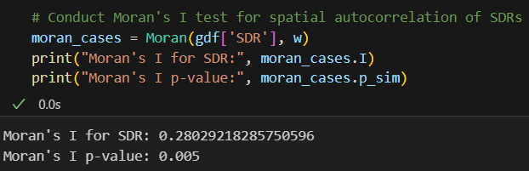
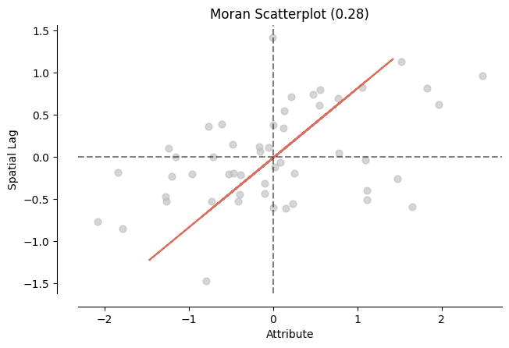
Spatial Autocorrelation by Moran’s I
Moran’s I statistics shows that there is a moderate positive spatial autocorrelation among the values of SDRs. This means that the states with similar value of SDRs are likely to be close to each other. Also the statistic is highly significant.
Moran scatterplot shows the relationship between variable value and its spatial lag. Spatial lag is the average value of variable in its neighbouring region.

Slide 8
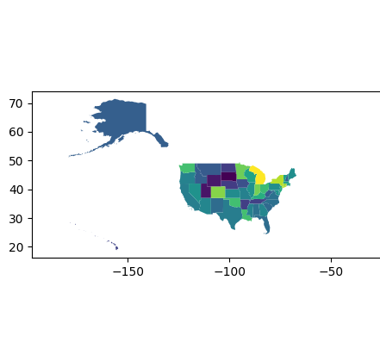
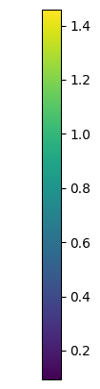
Layman’s approach - SDR plot

Slide 9
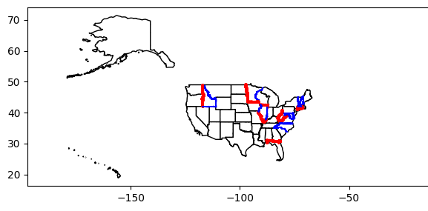
Traditional Crisp Wombling
Calculate difference between SDRs between each state and its neighbours.
Find the 50 percentile and 80 percentile of these boundary differences and mark the boundaries of the states whose boundary likelihood value exceeds 80 percentile value with red and with blue where boundary likelihood value exceeds 50 percentile value.

Slide 10
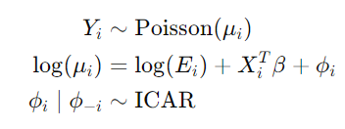




Hierarchical Modelling approach
Model Specifications -
Markov chain Monte Carlo (MCMC) samples g=1,2,...,1000
SDR is calculated by
BLVs are obtained by

Slide 11
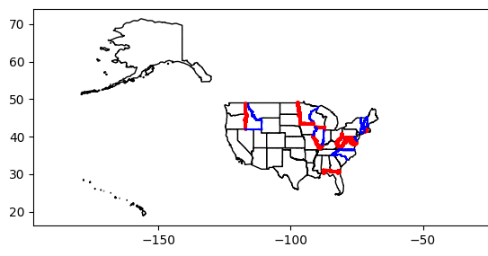
Hierarchical Modelling approach (contd.)
6. Find the 50 percentile and 80 percentile of these boundary differences and mark the boundaries of the states whose boundary likelihood value exceeds 80 percentile value with red and with blue where boundary likelihood value exceeds 50 percentile value.

Slide 12
Traditional Vs Hierarchical Approach

Slide 13
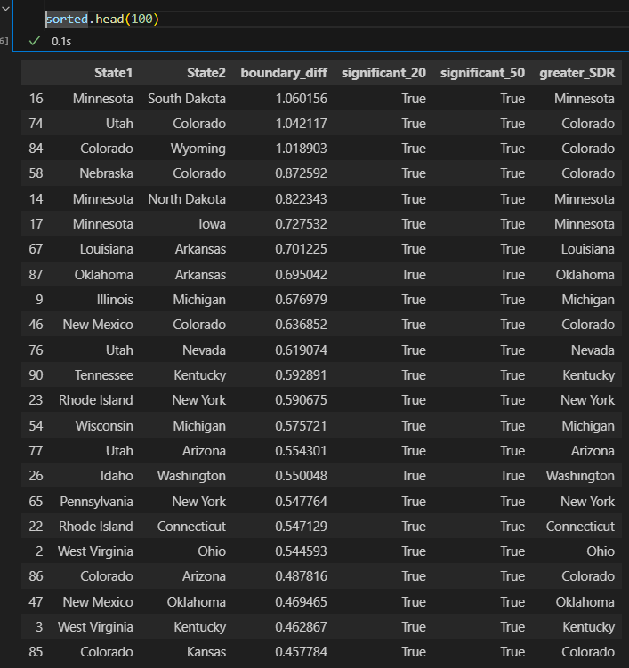
Results
The states of Minnesota, Colorado, Louisiana, Oklahoma, Michigan, Nevada, Kentucky, New York, Arizona, Washington, Connecticut, Ohio are the states where the deaths to confirmed cases ratio is significantly lower than their neighbouring states, hence signifying probable scope for improvement in healthcare facilities.

Slide 14
Thank you!

